Slide 1
Chapter 8
Deep Reinforcement Learning for Secure Internet of Things

Slide 2

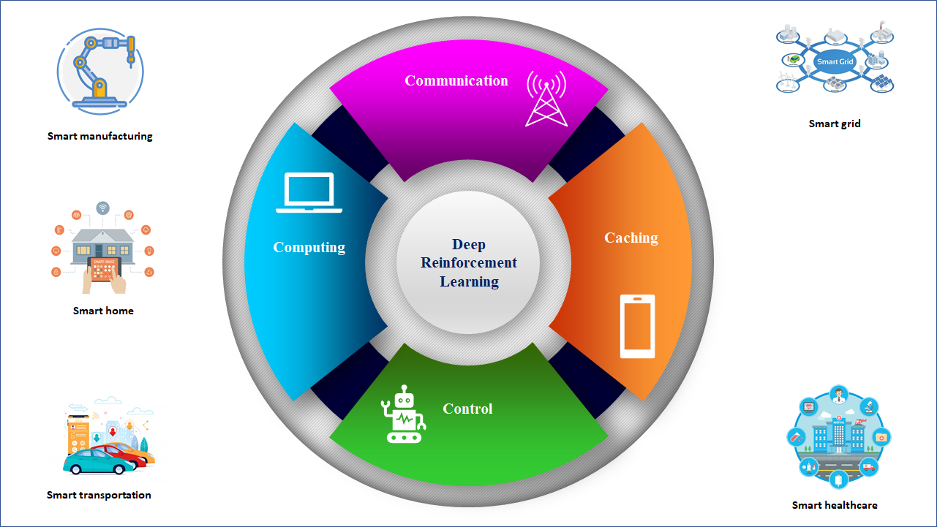
Foundations and Preliminaries

Slide 3
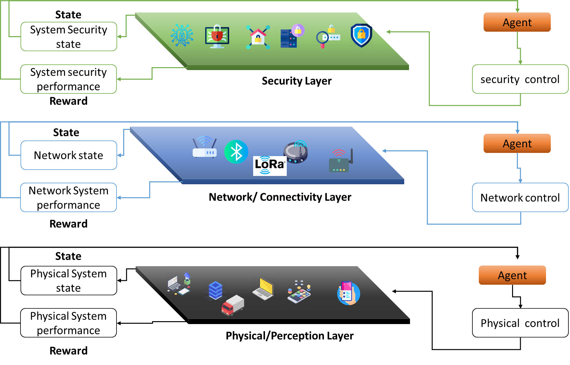
Single-agent Reinforcement Learning

Slide 4
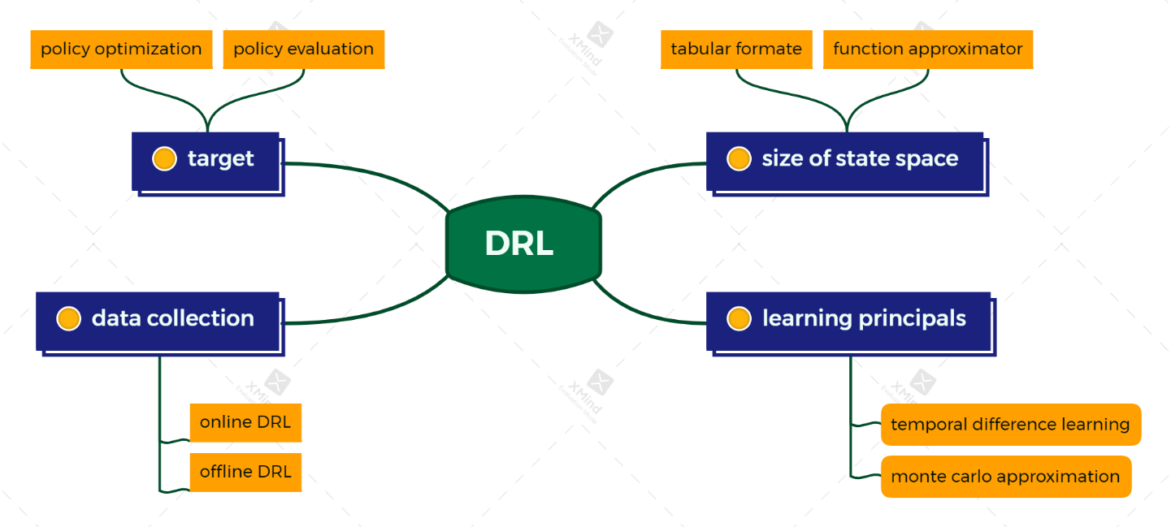
Multi-agent Reinforcement Learning

